Slide 1

WASTE MANAGEMENT

Slide 2

What is waste management?
Waste management include the activities and actions required to manage waste from its inception to its final disposal. This includes the collection, transport, treatment and disposal of waste, together with monitoring and regulation of the waste management process.

Slide 3
Contribution in adapting waste management
Individual:
Adopt 3 ‘R’s.
Usage of less plastic.
Family:
Segregating dry and wet waste.
Using resources like water/
electricity carefully.
Community:
At a community level, an initiative to collect wet waste from near by household should be incorporated, to make manure out of it by methods of composting.
Waste or sewage treatment plants should be put up to treat waste before dumping into water bodies.

Slide 4
Survey
While doing the survey in residential and commercial areas, the issue that was recognized was that in residential areas people are aware of waste management but don’t put efforts in segregating the waste. Where as in commercial areas people aren’t aware of it and dispose waste in an improper manner such as burning the dry waste collected.

Slide 5
Stakeholders of Waste Disposal Process
1. Ourselves.
- Disposing waste at home.
2. People collecting waste from the households.
- They collect the waste in small areas and dispose it in the BMC
garbage trucks.
3. The BMC trucks collect the waste from larger areas in Mumbai.
- They collect the garbage from the public bins on the streets.
4. Dumping grounds.
The waste is brought to the dumping ground by BMC trucks.
The oldest dumping ground is in Deonar.
There are 4 dumping grounds inMumbai; Deonar, Gorai, Mulund and Kanjurmarg.

Slide 6
Waste Management in Goa
Two separate trucks come to collect the garbage.
Wet waste goes for composting.
Dry waste goes to the waste management plant where its further segregated into plastic, paper, cloth, etc and reused/recycled accordingly.
This method of waste management should be incorporated in Mumbai as well all over India.

Slide 7
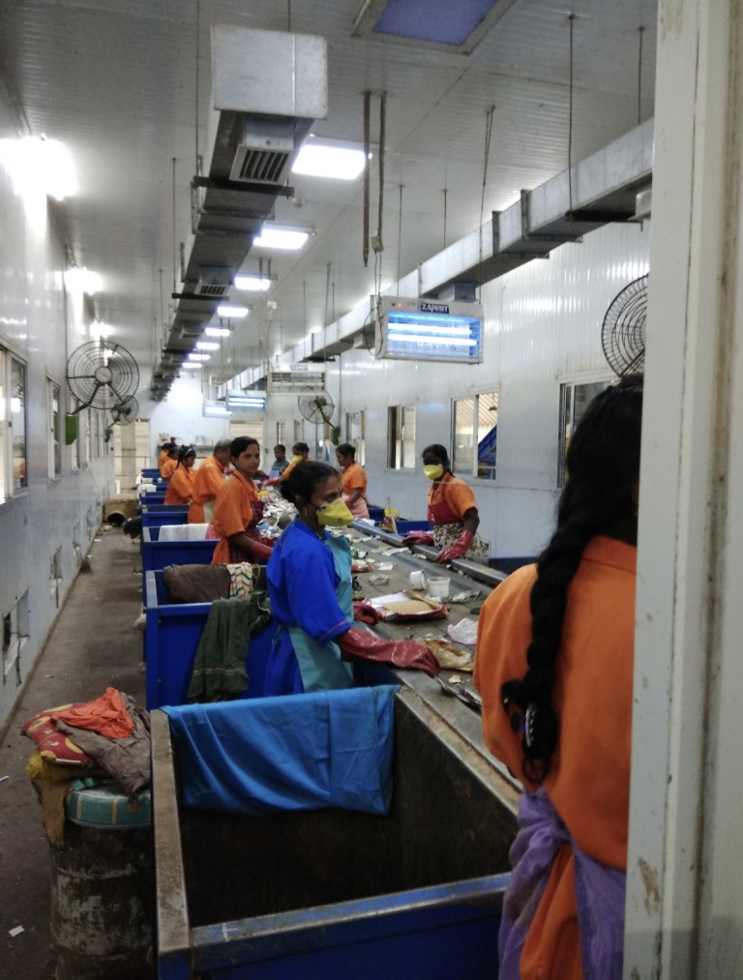
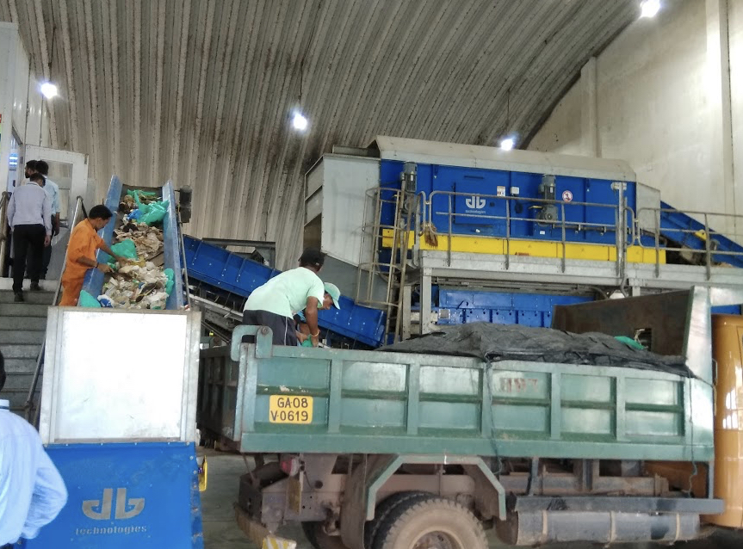

Slide 8

Waste Management
In Switzerland

Slide 9
Recycling the waste.
Switzerland itself generally has a successful waste management policy. But although the Swiss are great recyclers.
More than five million tons of urban refuse was produced in the country in 2006, of which around half was recycled. Most of the rest was incinerated.
More than 50 per cent recycling rate makes the country among the greenest in Europe.

Slide 10
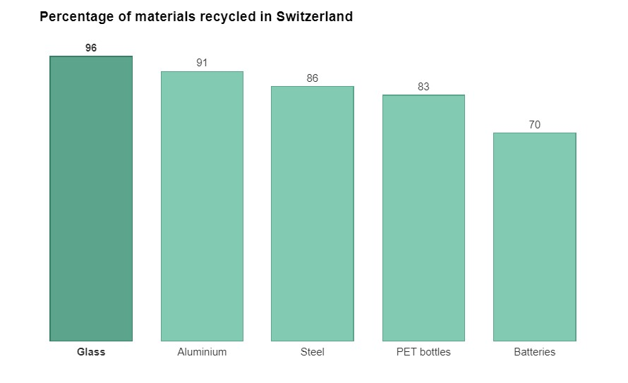

Slide 11
How Swiss deals with waste?
special garbage bags are required for garbage collection, and these bags are priced according to their size.
Garbage bags or stickers are available in all grocery stores and supermarkets.
Recycling collection points for glass, plastic, aluminium, paper, textiles and batteries are widely available.
Encouraging consumers to recycle.
Educating citizens about waste management through public schools or campaigns.

Slide 12
India
Swiss
No serious legal punishment for littering is implied.
Doesn’t know about the e-waste vividly and are experiencing problems lately.
There are no different bins for disposal of different kinds of materials.
There’s no spread of awareness or education about waste management.
Strict actions are taken for littering.
Switzerland is one of the very few countries with over a decade of experience in managing e-waste.
There are separate bins for each kind of recyclable material.
Almost every citizen is aware about waste management.

Slide 13
Waste Management
In Germany

Slide 14
Waste Generation
The German Waste Prevention Program, adopted in 2013, outlines existing and potential waste prevention measures at national, regional and local level. Alongside a host of advice, information and awareness-raising measures, together with research and development projects, the program also focuses on waste prevention strategies and incentives.

Slide 15
The German Closed Cycle Management Act
The act is aimed to turn the waste management into a resource management.
Act has made more people aware about waste separation lead to new disposal technologies and increased recycling capacities.
The Act states that whoever produces, markets and consumes goods is responsible for the recycling and reusing of the goods. Producers have to take the responsibility.

Slide 16
Bibliography
www.un.org
www.solarimpulse.com
www.swissinfo.com
https://enb.iisd.ord/consume/closed.html
https://www.bmu.ed
www.duetsche-recycling.de/epr
www.teriin.org

